Slide 1



BIG - H60 Consulting
Project Handover
Team 1
Empowering Aviators with Intelligent Tools for Clarity and Efficiency
Notes:
“Good Evening everyone.
Thank you for joining us today.
We are Team 1 from the Business Intelligence Group, and we had the opportunity to work with H60 Consulting on a project focused on empowering airline pilots through intelligent technology solutions.

Slide 2
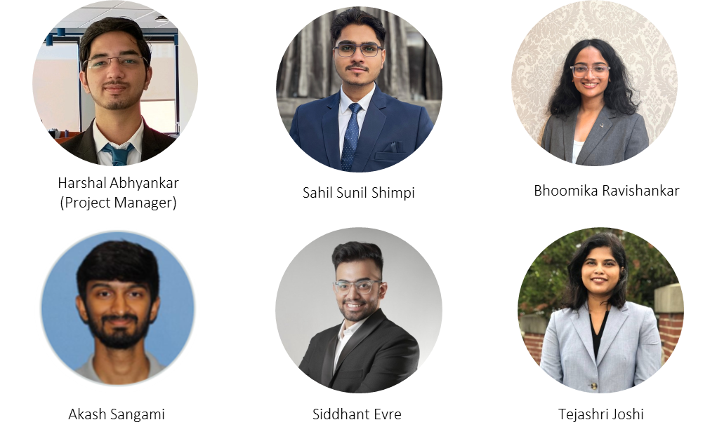
Meet Our Team!
Tejasri Joshi

Slide 3

Handover Overview
01
02
03
04
05
System Purpose
Functional Overview
System Inputs & Outputs
User Experience
Maintenance responsibilities

Slide 4
System Purpose
Smart Scheduling
Less Admin Intervention
Source References
Clause-Level Answers
Answer contract-related questions with clause-level precision
Provide references to source documents
Offer scheduling support based on contract rules
Reduce dependency on manual lookup and admin back-and-forth
CBA CoPilot empowers pilots with instant clarity, fewer delays, and smarter scheduling. All in one tool.
Notes:
ETL Processing Layer: Turns the collected info into a simplified format the system can understand.
• Database Layer: Think of this as the system’s ‘memory,’ storing all the contract rules and scheduling info.
• Backend Layer: The layer that interprets the rules, answers questions, and helps create the output.

Slide 5
Functional Overview
What the System Delivers Today
What the System doesn’t handle yet
Answer CBA Questions Intelligently Provides contract-based answers with contextual relevance.
Help Flight Assignment Scenarios Matches flights using seniority, aircraft type, and preferences.
Deliver Clause-Level References Includes exact rule details and document-level traceability.
Run Without External Systems Fully contained in a prompt—no setup, no login required.
Connect to a Live Database Uses static, pre-defined data instead of real-time pilot information.
Track Live Schedules or Logs Does not update with real flight assignments or operational changes.
Auto-Ingest New Contracts Requires manual prompt updates to reflect new CBAs or rule changes.
Personalize Across Sessions While it remembers information during a single session, it cannot persist user history or adapt across multiple uses.
Built to simplify decisions, reduce lookup time, and support day-to-day pilot needs.

Slide 6
System Inputs & Outputs
01
CBA PDFs – Full-text agreements from pilot unions
FAA Regulatory Documents – For duty time, rest requirements, etc.
Sample Flight Data (CSV) – Schedules, bids, preferences
System Inputs
02
Q&A with Citations – Clause-level answers linked to source documents
Pay Calculations – With breakdowns for aircraft type, duration, rate
Schedule Suggestions – Matches that align with contract + FAA rules
System Outputs
CBA CoPilot turns complex documents into clear, actionable insights.

Slide 7
AI-Powered CBA Insights
A Pilot's Journey to Contract Clarity
6.Pilot Receives Answer
2. UI Layer
4. Vector DB
Formats Query & Sends to Backend.
Stores and Retrieves CBA Data.
Formatted Answer + CBA References.
1. Pilot Query
Pilot initiates CBA inquiry via Chat Interface.
5. LLM
3. Backend
(RAG)
Generates Contextualized Response.
AI-powered search for contract clarity.
From Query to Compliance: Delivering Real-Time Support for Pilots

Slide 8
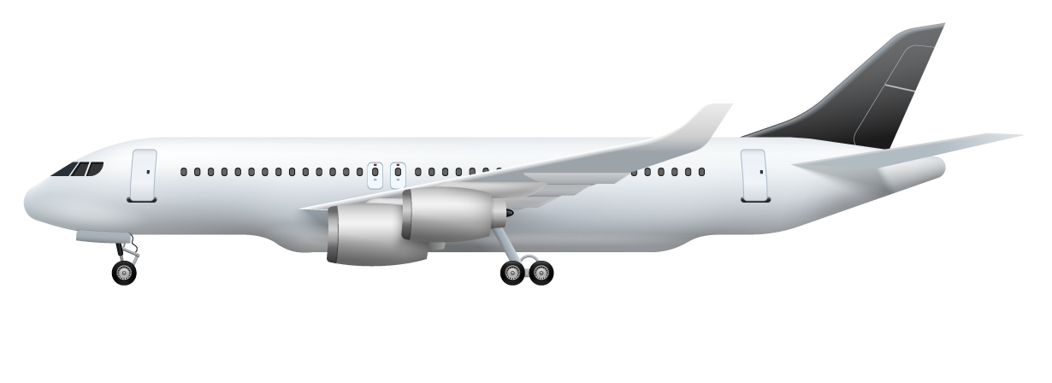
AI-Powered Flight Scheduling
Streamlined Process Enables Intelligent & Compliant Flight Scheduling
UI Layer
Scheduling Module
View Schedule
UI receives request and prepares it for the backend.
Flight schedule and its corresponding information.
Retrieves pilot data, preferences, FAA regulations, and flight info.
Pilot Query
Pilot submits request for flight schedule.
Database Lookup
Uses flight data and pilot profiles for informed decisions.
Rules Validation
Validates flight schedule against regulations document
Optimizing Flight Plans, Maximizing Pilot Wellbeing

Slide 9
Maintenance Responsibilities
Data Refresh
API Usage Monitoring
Document Updates
Prompt Optimization
Re-ingest new CBA and FAA documents as they are released.
Review and refine chatbot prompts for accuracy and tone.
Update pilot rosters, preferences, and sample flight schedules regularly.
Track GPT API calls and associated costs to manage budget.
Ongoing maintenance ensures the CBA CoPilot remains accurate, efficient, and ready for real-world use.
Notes:
ETL Processing Layer: Turns the collected info into a simplified format the system can understand.
• Database Layer: Think of this as the system’s ‘memory,’ storing all the contract rules and scheduling info.
• Backend Layer: The layer that interprets the rules, answers questions, and helps create the output.

Slide 10
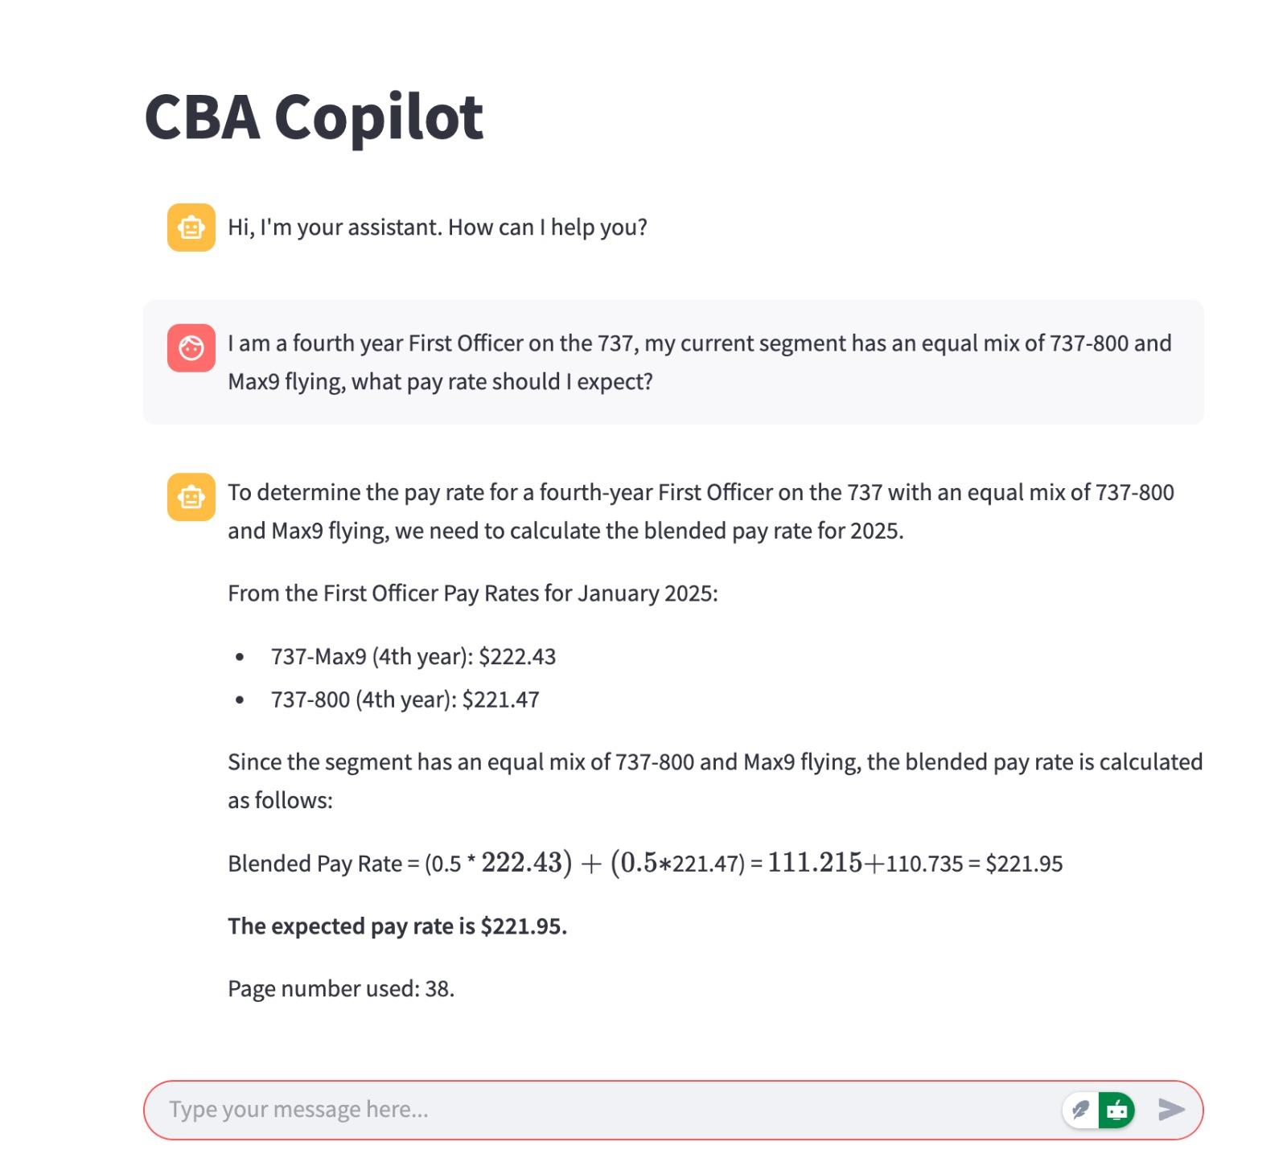
Handover Package Summary
You’ll receive:
Project Overview Slides – This document
Readme + Codebase – Setup & usage instructions
Executive Project Summary
Notes:
I am a fourth year First Officer on the 737, my current segment has an equal mix of 737-800 and Max9 flying, what pay rate should I expect?
If I have to fly from JFK, suggest unassigned short flights that I can pick for maximum pay?

Slide 11

Thanks!
Thank you for the opportunity to build CBA CoPilot. We hope it brings clarity and speed to your operations.
Feel free to reach out with any questions.
— Team 1, Business Intelligence Group (UIUC)

Slide 12
Bibliography
[1] Efficient chunking strategies for PDF information extraction with AI. (n.d.). Reddit. Retrieved from
https://www.reddit.com/r/LangChain/comments/1acudx2/efficient_chunking_strategies_for_pdf_information/
[2] Mastering PDFs: Extracting sections, headings, paragraphs, and tables with a cutting-edge parser. (n.d.). LlamaIndex Blog. Retrieved from
https://www.llamaindex.ai/blog/mastering-pdfs-extracting-sections-headings-paragraphs-and-tables-with-cutting-edge-parser-faea18870125
[3] Chunking PDFs and multimodal documents: Efficient methods for handling text, tables, and images. (n.d.). GOpenAI Blog. Retrieved from
https://blog.gopenai.com/chunking-pdfs-and-multimodal-documents-efficient-methods-for-handling-text-tables-and-images-for-467472f02d34
Notes:
I am a fourth year First Officer on the 737, my current segment has an equal mix of 737-800 and Max9 flying, what pay rate should I expect?
If I have to fly from JFK, suggest unassigned short flights that I can pick for maximum pay?

Slide 13
Bibliography
[4] How to chunk documents for RAG. (n.d.). Multimodal.dev. Retrieved from
https://www.multimodal.dev/post/how-to-chunk-documents-for-rag
[5] What is the best way to chunk a PDF file for RAG in a smart way that preserves meaning during retrieval? (n.d.). OpenAI Community Forum. Retrieved from
https://community.openai.com/t/what-is-the-best-way-to-chunk-a-pdf-file-for-rag-in-a-smart-way-that-preserves-the-meaning-during-retrieval/654863
[6] Parse and chunk documents | Vertex AI Agent Builder. (n.d.). Google Cloud. Retrieved from https://cloud.google.com/generative-ai-app-builder/docs/parse-chunk-documents
[7] Document processing. (n.d.). Palantir Documentation. Retrieved from
https://palantir.com/docs/foundry/ontology/document-processing/
[8] Using Document Intelligence to create chunks for index - How do I…? (n.d.). Microsoft Learn. Retrieved from
https://learn.microsoft.com/en-us/answers/questions/1608976/using-document-intelligence-to-create-chunks-for
Notes:
I am a fourth year First Officer on the 737, my current segment has an equal mix of 737-800 and Max9 flying, what pay rate should I expect?
If I have to fly from JFK, suggest unassigned short flights that I can pick for maximum pay?

Slide 14
Bibliography
[9] Azzouni, A. (n.d.). Text splitting & chunking for RAG applications. LinkedIn Pulse. Retrieved from
https://www.linkedin.com/pulse/text-splitting-chunking-rag-applications-abdelhadi-azzouni-zrvre
[10] Mastering RAG: Chunking techniques for enhanced document processing. (n.d.).GoPubby AI. Retrieved from
https://ai.gopubby.com/mastering-rag-chunking-techniques-for-enhanced-document-processing-8d5fd88f6b72
[11] Mastering RAG: Advanced chunking techniques for LLM applications. (n.d.). Galileo AI Blog. Retrieved from
https://www.galileo.ai/blog/mastering-rag-advanced-chunking-techniques-for-llm-applications
[12] In-depth review of chunking methods. (n.d.). KDB AI Learning Hub. Retrieved from
https://kdb.ai/learning-hub/articles/in-depth-review-of-chunking-methods/?utm_source=perplexity
[13] Advanced RAG 05: Exploring semantic chunking. (n.d.). Towards AI. Retrieved from
https://pub.towardsai.net/advanced-rag-05-exploring-semantic-chunking-97c12af20a4d
[14] 5 chunking strategies for RAG. (n.d.). Daily Dose of Data Science Blog. Retrieved from
https://blog.dailydoseofds.com/p/5-chunking-strategies-for-rag
Notes:
I am a fourth year First Officer on the 737, my current segment has an equal mix of 737-800 and Max9 flying, what pay rate should I expect?
If I have to fly from JFK, suggest unassigned short flights that I can pick for maximum pay?

